Slide 1

FINAL YEAR RESEARCH PROJECT
End-Term Presentation
AI BASED EARLY DISEASE RISK PREDICTION SYSTEM
USING MACHINE LEARNING
Supervised By: Dr. Bhanu Pratap Rajak
Group No.: 26-04
Name of the Student(s) with Regd. No.:
Priyansu Nayak – 2241014108
Subhojeet Sarkar – 2241019321
Himanshu Sekhar Dash – 2241014163
Pikesh Yadav – 2241025009
Department of Computer Sc. And
Engineering
Faculty of Engineering & Technology (ITER)
Siksha ‘O’ Anusandhan (Deemed to be) University
Bhubaneswar, Odisha
1

Slide 2
Presentation Outline
Problem Statement & Motivations
Problem Statement
Motivations
Literature Review
Existing Solutions & Limitations
Proposed Methodology & Approach
Key Components/Modules & Algorithms Used
Dataset(s) & Tools/Technologies
Experimentation
System Specification
Experimental Results
Performance Analysis
Conclusion and Future Scope
References
2

Slide 3
Problem Statement
Chronic diseases such as diabetes and Cardiovascular disease are becoming more common and often go unnoticed in the early stages. If they are not detected early, they can lead to serious health problems and increased medical costs.
Traditional diagnosis methods depend on manual medical examinations, which can take time and may not always provide quick results. Therefore, there is a need for a simple and intelligent system that can identify disease risk at an early stage.
This project aims to predict the risk of diabetes and Cardiovascular disease using a person's health and lifestyle information. It uses machine learning techniques and provides predictions through an web interface.
3

Slide 4
Motivations
To help people identify chronic disease risks at an early stage before serious complications occur.
To reduce dependency on costly and time-consuming traditional medical screening methods.
To use machine learning techniques for improving accuracy and reliability in disease prediction.
To develop an easy-to-use healthcare interface that supports preventive care and healthy lifestyle management.
4

Slide 5
Literature Review
Table 1:Summary of Existing Approaches and Research Limitations
S. No. | Author & Year | Method / Technique used | Dataset Used | Research Outcomes | Findings
1 | Almustafa (2020) | KNN, SVM, AdaBoost + Feature Selection | Heart Disease Dataset | High classification performance achieved Best model : KNN | Feature selection significantly improved prediction accuracy
2 | Deberneh & Kim (2021) | ANN, RF, XGBoost, LR, ANOVA, Chi-Square, RFE | Electronic Health Record (EHR) Dataset | Accuracy: 95.0% Best model: XGBoost | Important diabetes risk factors were successfully identified
3 | Rajendra & Latifi (2021) | Logistic Regression + Ensemble Learning | Diabetes Dataset | Accuracy: 90.0% | Ensemble learning improved diabetes prediction robustness
4 | Poonia et al. (2022) | LR, SVM, NB, KNN, ANN + RFE + Chi-Square | UCI CKD Dataset (400 records) | 98.75% accuracy achieved Best model: LR | LR + Feature selection improved CKD detection
5 | Ahmad et al. (2022) | Mixed Machine Learning Approach | Heart Disease Dataset | Accuracy: 93.0% | Multiple clinical features improved heart disease prediction.
5

Slide 6
Literature Review
S. No. | Author & Year | Method / Technique used | Dataset Used | Research Outcomes | Findings
6 | Hassan et al. (2022) | RF, DT, SVM, KNN, ML Classifiers | Coronary Heart Disease Dataset | Accuracy: 96.0% | ML supported early cardiovascular risk assessment
7 | Islam et al. (2022) | XGBoost, RF, DT, KNN, SVM | CKD Dataset | High CKD classification accuracy | XGBoost achieved high CKD prediction performance.
8 | Uddin et al. (2023) | DT, RF, XGBoost, AdaBoost, SVM, MLP | Combined Heart Disease Dataset | Decision Tree achieved highest performance | Combined datasets improved cardiovascular disease prediction.
9 | Nguyen et al. (2023) | LR, DT, RF, KNN, SVC, AdaBoost, GB | Type-2 Diabetes Dataset | Effective physician-support tool | ML improves diabetes diagnosis
10 | Alzboon et al. (2025) | RF, DT, LR, KNN, SVM, Neural Network | Pima Indians Diabetes Dataset | Neural Network performed best Accuracy achieved:78.57% | NN and RF models demonstrated effective diabetes prediction capability using clinical health parameters.
6

Slide 7
Research Gap & Improvements
Research Gaps Identified:
Most systems focus on a single chronic disease (either diabetes or cardiovascular disease) instead of a multi-disease prediction system.
Although several studies compare multiple machine learning algorithms, many do not integrate feature selection, class imbalance handling, hyperparameter optimization, and threshold tuning within a single prediction framework.
Existing systems often use default prediction thresholds (0.5), reducing reliability on imbalanced healthcare datasets.
Some systems fail to properly handle class imbalance, leading to biased prediction performance.
Many existing studies focus primarily on model development and evaluation, with limited emphasis on user-friendly deployment for real-time prediction.
7

Slide 8
Research Gap & Improvements
Improvements :
Develop a multi-disease prediction system for Diabetes and Cardiovascular Disease on a single platform.
Apply data preprocessing, feature selection and SMOTE to improve prediction accuracy.
Compare multiple machine learning models (Logistic Regression, Random Forest, SVM, and XGBoost) and use hyperparameter optimization to select the best model.
Implement threshold-based risk classification (Low Risk / High Risk) for better decision-making.
Develop a Streamlit web application for real-time prediction and user-friendly interaction.

Slide 9
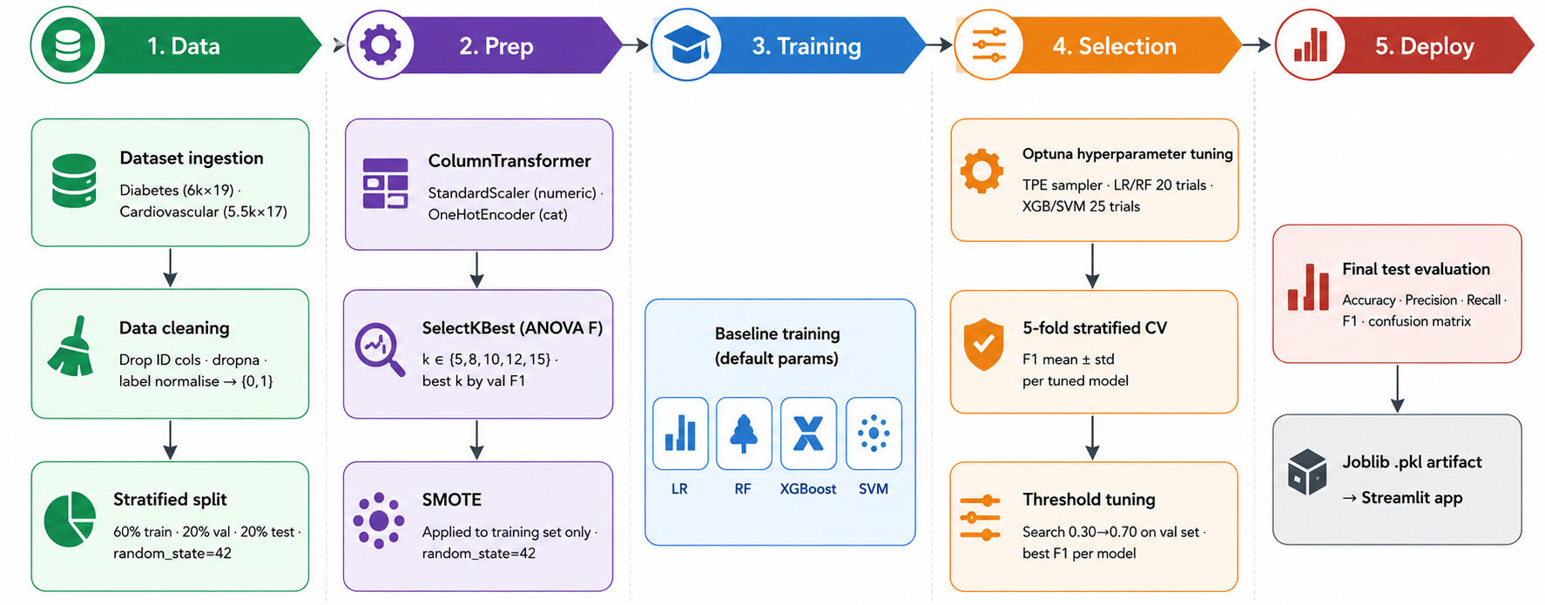
Proposed Solution & Architecture
Fig. 1: Schematic Workflow for Disease Risk Prediction
9

Slide 10
Proposed Solution & Architecture
System Workflow:
Dataset Collection (Diabetes: 6000 records, 19 features and Cardiovascular: 5500 records, 17 features).
Data Splitting: 60% training, 20% validation, 20% testing .
Data Preprocessing using ColumnTransformer : StandardScaler and OneHotEncoder.
Feature Selection: SelectKBest with ANOVA F-statistic.
Class Imbalance Handling: SMOTE applied to training set.
Model Training: Logistic Regression, Random Forest, SVM, and XGBoost.
Hyperparameter Optimization using Optuna.
Cross Validation & Threshold Tuning : 5-Fold CV and best F1-score selection.
Model Serialization with Joblib .pkl model saving.
Deployment via Streamlit web interface run locally.

Slide 11
Dataset & Tools/Technologies
Datasets Used:
Diabetes Dataset: 6,000 patient records with 19 features (glucose level, BMI, blood pressure, insulin, age, physical activity, etc.)
Cardiovascular Dataset: 5,500 patient records with 17 features (cholesterol, blood pressure, heart rate, lifestyle habits, etc.)
Tools & Technologies:
Programming Language : Python
Libraries : Pandas, NumPy, Scikit-learn, Matplotlib, Seaborn, Joblib, Streamlit, XGBoost.
Preprocessing : StandardScaler, OneHotEncoder, SMOTE
Feature Selection : SelectKBest (ANOVA F-statistic)
Model Training : Logistic Regression, Random Forest, SVM, XGBoost
Hyperparameter Optimization : Optuna
Model Storage and Deployment : Joblib (.pkl files) and Streamlit
Development Environment : Visual Studio Code
11

Slide 12
Experimentation
System Specification:
The AI-Based Early Disease Risk Prediction System was developed using Python 3.10 and tested on a Windows 11 system with 8 GB RAM.
The project used machine learning libraries such as NumPy, Pandas, Scikit-learn, XGBoost, Matplotlib, and Seaborn for data preprocessing, model training, and visualization.
Streamlit was used to create an interactive web interface for real-time disease prediction, while Joblib was used to store trained machine learning models in .pkl format for efficient deployment.
Visual Studio Code (VS Code) was used as the development environment for coding and testing.
12

Slide 13
Experimentation
Experimental Results:
Four ML models were trained and compared: Logistic Regression, Random Forest, SVM, and XGBoost..
Models were optimized using Optuna and evaluated using 5-Fold Stratified Cross Validation.
Diabetes Prediction: SVM achieved the best performance (Accuracy: 94.42%, F1-score: 94.99%).
Cardiovascular Prediction: Logistic Regression achieved the best performance (Accuracy: 96.36%, F1-score: 97.22%).
SMOTE and threshold optimization improved model reliability and classification performance.
Final models were deployed through a Streamlit web application for real-time prediction.
13

Slide 14
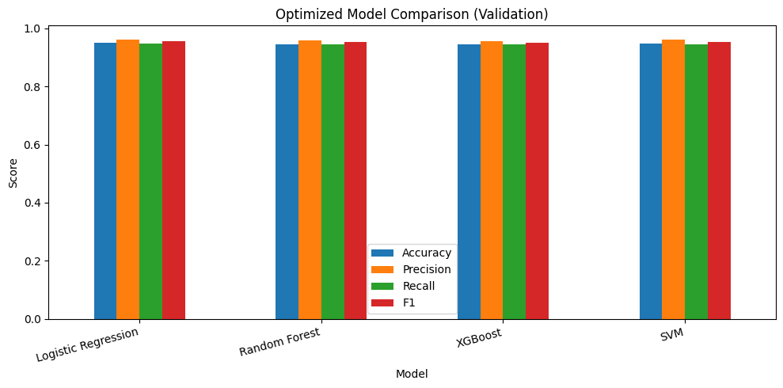
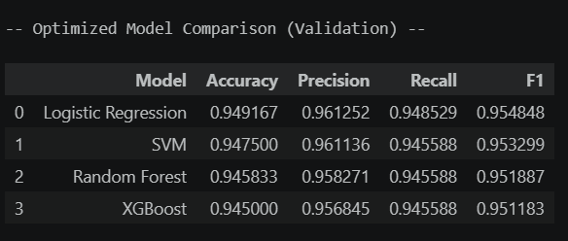
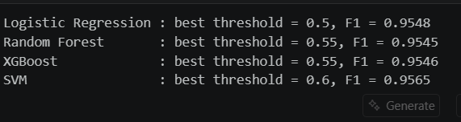
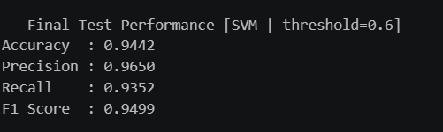
Experimentation
Experimental Results: Diabetes Disease
Fig. 2: Validation Performance Comparison, Threshold Optimization, and Final Test Results for Diabetes Disease Prediction
14

Slide 15
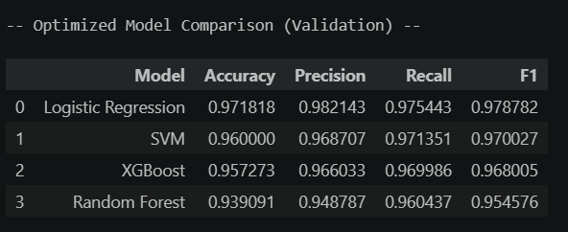
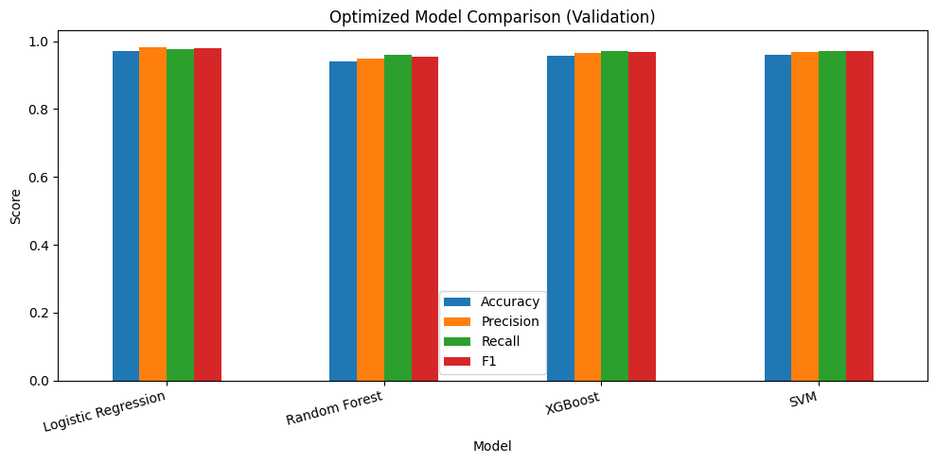
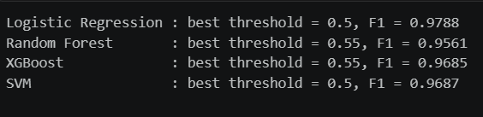
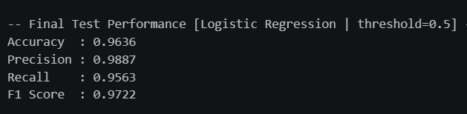
Experimentation
Experimental Results: Cardiovascular Disease
Fig. 3: Validation Performance Comparison, Threshold Optimization, and Final Test Results for Cardiovascular Disease Prediction
15

Slide 16
Experimentation
Performance Analysis:
Performance analysis was carried out to evaluate the speed, reliability, and responsiveness of the disease prediction system.
The Streamlit interface smoothly handled user inputs and displayed prediction outputs without major delays.
The use of Joblib model loading improved runtime efficiency because the models were loaded directly instead of retraining during every prediction request. However, a small delay was observed during the initial startup due to model and library loading.
Training time also increased during cross-validation and threshold tuning because the models were trained multiple times on different dataset combinations.
Overall, the system demonstrated reliable prediction capability with low latency and accurate performance for both disease prediction modules.
16

Slide 17
Conclusion and Future Work Plan
Conclusion:
The AI-Based Early Disease Risk Prediction System was successfully developed and deployed for diabetes and cardiovascular disease using supervised machine learning. Multiple ML models were trained, compared, and evaluated. SVM and Logistic Regression were selected as the best models, achieving 94.42% and 96.36% accuracy respectively.
Key contributions include: multi-disease prediction, SMOTE-based imbalance handling, threshold tuning, and a user-friendly Streamlit web interface.
Future Work Plan:
Extend prediction for more chronic diseases like kidney disease, liver disease.
Use larger real-time healthcare datasets for improved generalization
Integrate deep learning (ANN)
Add Explainable AI techniques (SHAP, LIME) .
Improve accuracy using advanced optimization methods (LightGBM).
17

Slide 18
References
[1] | A. Almustafa, “Prediction of heart disease and classifiers’ sensitivity analysis,” BMC Bioinformatics, vol. 21, no. 1, pp. 1-18, 2020.
[2] | T. Deberneh and I. Kim, “Prediction of type 2 diabetes based on machine learning algorithm,” International Journal of Environmental Research and Public Health, vol. 18, no. 6, pp. 1-16, 2021.
[3] | P. Rajendra and S. Latifi, “Prediction of diabetes using machine learning and ensemble techniques,” Smart Health, vol. 24, pp. 100245, 2021.
[4] | R. C. Poonia, S. Singh, M. A. Hossain, et al., “Chronic kidney disease prediction using machine learning techniques,” Healthcare, vol. 10, no. 2, pp. 371, 2022.
[5] | Z. Ahmad, A. Rahim, N. Zubair, et al., “Heart disease prediction using machine learning techniques,” Applied Sciences, vol. 12, no. 15, pp. 7449, 2022.

Slide 19
References
[6] | C. A. Hassan, M. A. Hossain, and M. R. Islam, “Coronary heart disease prediction using machine learning algorithms,” Sensors, vol. 22, no. 19, pp. 7227, 2022.
[7] | M. M. Islam, M. Hasan, and M. S. Rahman, “Machine learning based chronic kidney disease prediction,” Scientific Reports, vol. 13, pp. 40717, 2023.
[8] | S. Uddin, M. M. Rahman, and M. S. Islam, “Cardiovascular disease prediction using machine learning techniques,” Smart Health, vol. 29, pp. 100377, 2023.
[9] | T. Nguyen, H. Nguyen, and T. Pham, “Type-2 diabetes prediction using machine learning algorithms,” Diagnostics, vol. 13, no. 12, pp. 2087, 2023.
[10] | M. Alzboon, A. Alkhateeb, and M. Alzyoud, “Diabetes prediction using machine learning techniques,” arXiv preprint arXiv:2506.10180, 2025.

Slide 20

20

